Slide 1
Array& Object

Slide 2
Array
Definition:
JavaScript arrays are used to store multiple values in a single variable (W3School)
Declaration:
var myArr = [ ];
let myNewArr = [ ];
const myArray = [ ];
var myOtherArr = [1, 2, 3, 4, “Hello”, “World”, 9, 10];
W3School. 1999-2019. URL: https://www.w3schools.com/js/js_arrays.asp. Accessed: 16 Apr 2019.

Slide 3
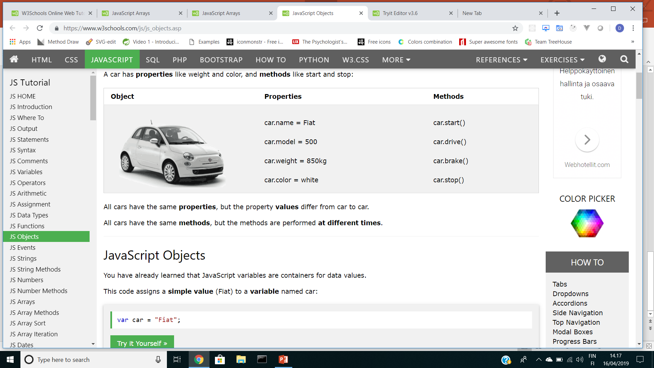
Object
W3School. 1999-2019. URL: https://www.w3schools.com/js/js_objects.asp. Accessed: 16 Apr 2019.

Slide 4
Array & Objects
Example:
- Array declaration with no values: `const myArray = []`
- Array declaration with values: `const myArray = ["a", "b", "c"]`
- Array methods most used: `myArray.length, myArray.assign(), myArray.join(), myArray.toString(), myArray.push(), myArray.pop(), myArray.shift(), myArray.unshift()`
- Object declaration with no values: `const myObject = {}`
- Object declaration with no values: `const myObject = { a: a, b: b, b: c, d, d }`
W3School. 1999-2019. URL: https://www.w3schools.com/js/js_arrays.asp. Accessed: 16 Apr 2019.

Slide 5
<!DOCTYPE html>
<html>
<head>
<meta charset="UTF-8" />
<title>About Arrays</title>
</head>
<body>
<div class="container">
<section class="section-area">
<h1 class="header">Car List Program</h1>
<label>Type</label>
<input type="text" id="type" />
<label>Model</label>
<input type="text" id="model" />
<label>Color</label>
<input type="text" id="color" />
<label>Price</label>
<input type="text" id="price" />
<button onclick="saveCar()">Save</button>
<button onclick="showCar()">Show List</button>
<p>List Cars Here</p>
<p id="showCar"></p>
</section>
</div>
</body>
</html>

Slide 6
* {
padding: 0;
margin: 0;
}
body {
font-family: Helvetica, Arial, sans-serif;
line-height: 1.3;
}
.container {
text-align: center;
}
.header {
color: blue;
}

Slide 7
alert(”Hello World)”

